Slide 1
Portland Psychotherapy: Our model for conducting research outside of the Ivory Tower
Jenna LeJeune, Ph.D.
Notes:
Being up here feels like the culmination of a lot of time and hard work Jason and I have been doing for the past several years. This is the first time I’ve been able to speak publicly about how we’ve been able to set up portland psychotherapy to be able to do significant research inside our center. And I feel very privileged and humbled to be able to do so.
I’m the co-founder, along with Jason Luoma of Portland Psychotherapy Clinic, Research, & Training Center where I’m also the Director of Clinical Services. While we are a corporation, we are not set up like most corporations to maximize profit, but instead work to maximize social good through science

Slide 2
Clinic
Strive to make quality, science-based psychotherapy available to all members of our community.
Research
Use contextual behavioral science to develop novel methods to help people live better lives and alleviate suffering
Training Center
Provide training to help other professionals bring more compassion and vitality to their work and to support them in using contextual behavioral science to guide their practice.
Notes:
Jason and I formed Portland Psychotherapy in 2007 in part because we wanted to both apply and contribute to contextual behavioral science through both clinical work and research. But, we wanted to be able to do that research outside of a traditional academic setting. In addition to being a private outpatient psychotherapy center, we are also an independent, self funded research and training center.

Slide 3
Our mission
We use contextual behavioral science to guide compassionate, effective psychological services and contribute to the wider community through research and training.
Notes:
Today I’m mainly going to be talking about the research part of our center, describing how we are have created a model in which we are able to do research outside of an academic setting and without having to rely on grant funding (which we all know can be pretty precarious).
All our research is funded through the income in our fee-for-service clinical services. So essentially, we run our clinic functionally as we would a non-for-profit. So all profits that we make on our clinical work beyond the salaries we pay our employees and our overhead expenses (that is, seeing clients, running groups, etc.) go to fund our research.

Slide 4
Why isn't there more CBS research happening in clinical settings?
Notes:
Raise your hand if you were trained in a scientist-practitioner model? So if there were so many of us who were trained to be both utilizers of AND contributors to research as clinicians, than why do you think there isn’t more research happening in clinical settings? Ask for people to shout out their ideas. Encourage and validate their responses.
I’d say there are two main barriers people outside of academia face when trying to do research:

Slide 5
MONEY
LOGISTICS
Notes:
In my talk today I’m going to focus on two main groups of barriers, money and logistics and how we’ve tried to address them in our Center

Slide 6
Money
Notes:
So yes, certain money is one of the biggest barriers to conducting research in clinical in private fee-for-service setting. But maybe not in the way you think. You might be thinking it is lack of money. But I would argue that that’s not it at all.

Slide 7
Money is a bully!
Notes:
Instead, I think that in these fee-for-service setting, money becomes a bully! It tends to be too strong of a motivator. The contingencies in these settings around money are so tight that they are hard to overcome. Imagine I gave you the option of doing two things over the next hour. You could sit down with someone and talk to them for an hour and receive $150 or you could write a draft of a results section. Its hard to let go of that contingency, especially for people who are successful clinicians and have clients beating down their door. You have to somehow be willing to turn down the money and also turn down the suffering people who are knocking at your door.

Slide 8
Money is a bully
Money shapes us to select activities that generate immediate, short-term profits (like seeing “just one more” client)
Extrinsic rewards (like money) tend to motivate people to work harder, but in many cases results in less creativity.
This is not good when the goal is producing new ideas, as in research.
Notes:
When behaviors are paired with extrinsic rewards, like money, those behaviors tend to increase in frequency. In other words, getting paid will likely increase the behavior that resulted in the payment (i.e. see more clients). However, the relationship between extrinsic rewards and creativity is much more complicated and there is much evidence to suggest that extrinsic rewards, like money, tend to result in decreased creativity. Thus, a contingency oriented so strongly around an extrinsic reinforce such as money, as it is in most clinical practices, is highly problematic when the goal is producing novel ideas, as it is in research.

Slide 9
Notes:
What we needed to do in our center is to find ways to protect ourselves and our employees from the money bully, so that we can preserve our motivation to engage in activities that contribute to the social good, but are not immediately revenue generating.

Slide 10
How we protect our employees from the bully
Give them a fair, fixed salary to support the research portion of their work
Devoted research days - (no trading time for dollars)
Notes:
If extrinsic rewards like money can actually kill creativity and motivation. The goal isn’t to pay people a lot because that won’t help them to be more productive. Instead, we want to pay them fairly. And that salary is fixed. We don’t need to chase grants for that money. Instead, all of the money that we use to pay our the research at our Center comes from the profits we make from seeing client.
In addition, our staff have devoted research time, which varies from ½ day a week to 3 days a week depending on what they have contracted with us for.

Slide 11
Build intrinsic motivation by supporting…
Choice
Mastery
Purpose
Notes:
Instead of relying on extrinsic motivators, we wanted to be sure to be intentional about building up the intrinsic motivators. We do this through three main ways.
1. Choice/Autonomy – Is the desire to direct our own lives.
2. Mastery — the urge to get better and better at something that matters.
3. Purpose — the yearning to do what we do in the service of something larger than ourselves.

Slide 12
Choice
Flexible work schedules and caseloads
Employees are free to select the projects they work on
Employees get a say in how much of their time is spent on research, training, or clinical work and those ratios can change
Notes:
Flexible work schedule and caseloads: Our staff are free to set their own schedules, choose how many and which types of clients they would want to see. Their non-research income is commission based, with an expected minimum which allows them more choice and flexibility when it comes to earning income through clinical work
For their non-clinical work, they are free to select which projects they would like to work on, in what capacity, with whom, and how.

Slide 13
Mastery
Encourage the development of expertise
Provide mentorship on how to learn
Bring in outside experts to provide training in areas where our staff want to gain mastery
Staff set their own goals and the group helps them track their progress
Lab meetings where we learn from other’s expertise in an atmosphere of support and collaboration rather than competition
Notes:
We encourage the development of expertise. Provide mentorship on how to learn. And we also bring in outside trainers/experts to help us develop that expertise. Here at our Center, we have varying levels of experience when it comes to conducting research. Staff with expertise in a particular area can function as “consultants” to support others’ projects. Research lab meetings allow us to share that learn from others in the Center in a non-competitive environment (we’re not all competing for coveted, limited funding dollars). This creates an atmosphere of support and collaboration. Lab meetings and other regular reviews of goal attainment. Staff set their own research goals and then the group helps track their progress on those goals

Slide 14
Connect people with their core values
Make sure that reviews address alignment between values and goals
Have meaningful, values-based organizational mission that everyone feels highly committed to
We honor our clients, whose work and money allow us to make a broader impact through our research
Purpose
Notes:
Values and mission statement:
The people who come to work with us could are all exceptional clinicians and talented researchers. They could all be making significantly more money if they chose to be in a solo private practice or even in an academic position. However, they have all chosen to work with us explicitly because it does align with their values. Their work is tied in to this greater mission and are able to structure a work program, that can include various activities including doing direct service clinical work, research, training, teaching, supervision– and all are tied in to a mission that they care deeply about. So that’s how we address the money bully barrier, but then come the logistical barriers

Slide 15
Logistical and Social Barriers
Notes:
Many of the institutional supports that researchers in academia and other research settings take for granted are not present in fee-for-service settings. Many things we didn’t even realize before we started trying to do research outside of traditional academic settings. For example, when we were trained to be scientist-practitioners, and told that we can (and should?) be both consumers of and contributors to research as clinicians, no one ever mentioned some of the boring logistics like, how do you do research without access to an IRB? How do you write up that study without easy access to journal articles? The solo scientist-practitioner can see these things as real barriers.
Few scientists are productive in isolation. Access to research collaborators can often be difficult and is not as simple as when in an academic department when several other researchers are located close by. Most researchers also do not have the expertise to complete all the research tasks on their own and need collaborators of consultants to provide expertise in statistics, novel research methods, or the use of scientific equipment.

Slide 16
Many of the perceived barriers can be overcome with one thing…
COMMUNITY
Notes:
Research within academia works in large part because it’s a pre-made community. But there is no reason why we can’t create a research/learning community outside of academia.
Community is key to how our Center can function. Both a community within the Center, with people coming together with various talents, interests and backgrounds who can all contribute in unique ways to our mission. To our larger community in Portland and Oregon in general. To the worldwide ACBS community. It is only through utilizing the skills and resources that are available in this boarder community that then the perceived logistical barriers become possible to overcome. For example
Several of us from around the country who are doing research outside of academia got together and formed an IRB
We’ve developed relationships and a reputation in Portland as a place where students can get research experience, and we currently have several research assistants who volunteer their time to run subjects for us and help with recruitment
We’re able to get access to nearly all of the articles we need either through our local library’s interlibrary loan program or through the Oregon Health Sciences University which has a program for outside clinicians to have limited library privileges
We collaborate with our colleagues who are in academic settings and who have access

Slide 17
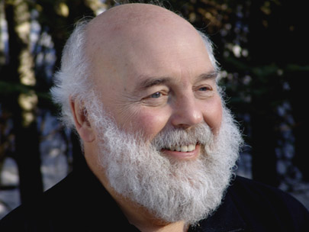
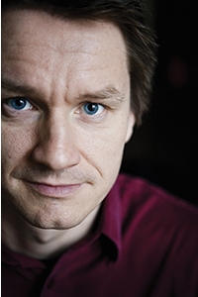
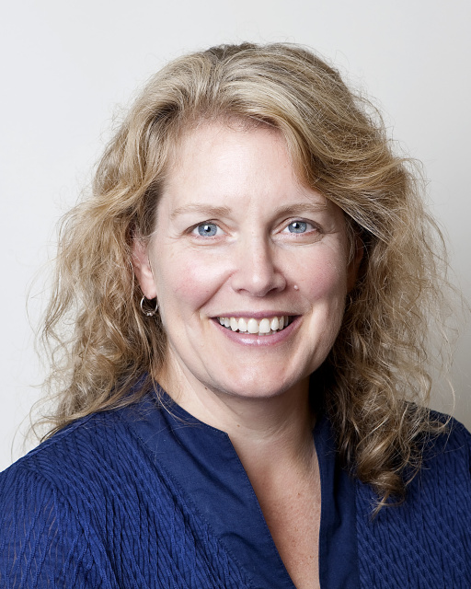
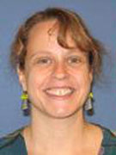
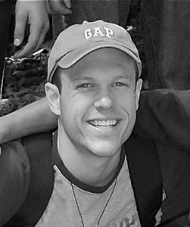
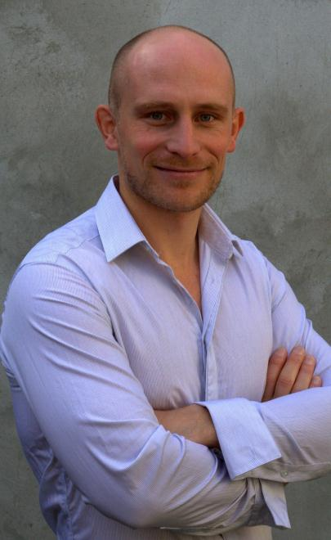
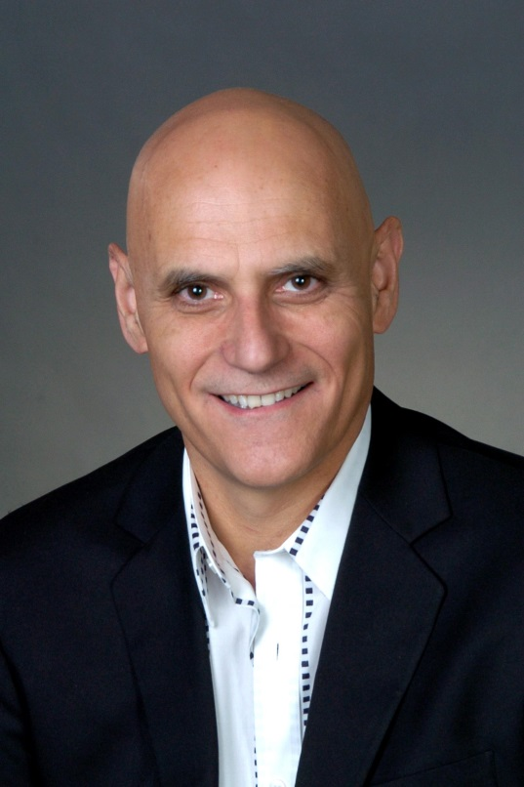
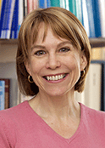
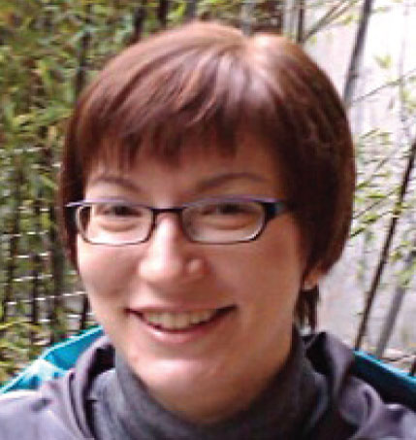
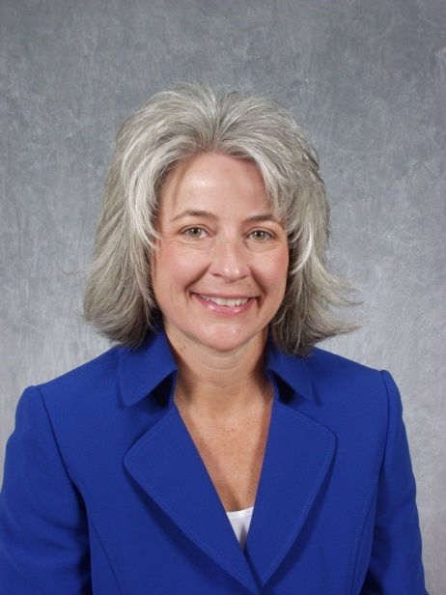
Notes:
Here are just a few of the people from around the world that we have the privilege of getting to collaborate with

Slide 18
How is this working for us?
10 employees, including 2 postdoctoral fellows + four volunteer research assistants
We’ve funded 5 ACT/CBS focused postdoctoral fellowships
All full time employees are paid a fair salary with benefits, with very flexible work schedules and more vacation time than is typical in comparable positions
We are able to provide high quality, science-based therapy to approximately 100 clients a week including numerous sliding scale/low fee clients
Last year approximately 18% of our total revenue went directly to fund our various research projects
Our clinical revenue supports all stages of the research cycle, from study design, to data collection, to analysis and publication.
Notes:
Jason and I created our Center in 2007. At that time it included he and I and one postdoctoral fellow.

Slide 19
Current research projects include
Perspective taking/RFT
False memory
Predictors of substance misuse
Interventions for chronic self-criticism and shame
Training and dissemination research
Curriculum to decrease mental health stigma
Decreasing substance abuse relapse
Health promotion in higher education
Sexual health and risk behaviors
ACT-based exposure techniques
Notes:
Nearly all of our clinical staff have some dedicated (and paid for) research time ranging from ½ day a week to 3 days a week
Most of our clinical staff are also involved in research and programs of research range from basic to applied science. Current active topics of research include basic research on perspective taking (RFT citation) and false memory (DRIFT citation), longitudinal research on predictors of substance misuse, interventions for chronic self-criticism and shame, dissemination of evidence-based therapies, interventions to reduce mental illness stigma, and health promotion in higher education

Slide 20
So far so good…
Notes:
So from 2007 when just three of us sharing a one-room office just about 6 weeks ago we just finished renovating this lovely Victorian in which we will eventually have 17 offices

Slide 21
Let me know if I can help. jlejeune@portlandpsychotherapyclinic.com
You can make a meaningful contribution to research in your setting.

